Slide 1




Indexes

Slide 2
What is an index
Indexes are special data structures associated with tables or views that speeds retrieval of rows from the table
The users cannot see the indexes, they are just used to speed up searches/queries.
SQL Server provides two types of indexes: clustered index and non-clustered index.

Slide 3
Clustered Indexes
A clustered index sorts and stores the data rows of the table or view in order based on the clustered index key.
A clustered index determines the physical order of data in a table. For this reason, a table can have only one clustered index because data rows can be only sorted in one order.
When you create a PRIMARY KEY constraint, a unique clustered index on the column or columns is automatically created if a clustered index on the table does not already exist.
A clustered index organizes data using a special structured so-called B-tree (balanced tree) which enables searches, inserts, updates, and deletes in logarithmic amortized time

Slide 4
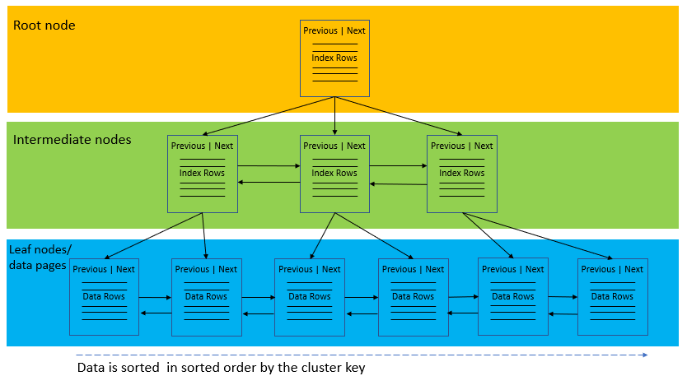
B-tree
In this structure, the top node of the B-tree is called the root node.
The nodes at the bottom level are called the leaf nodes. Any index levels between the root and the leaf nodes are known as intermediate levels.
In the B-Tree, the root node and intermediate level nodes contain index pages that hold index rows. The leaf nodes contain the data pages of the underlying table.
The pages in each level of the index are linked using another structure called a doubly-linked list.

Slide 5
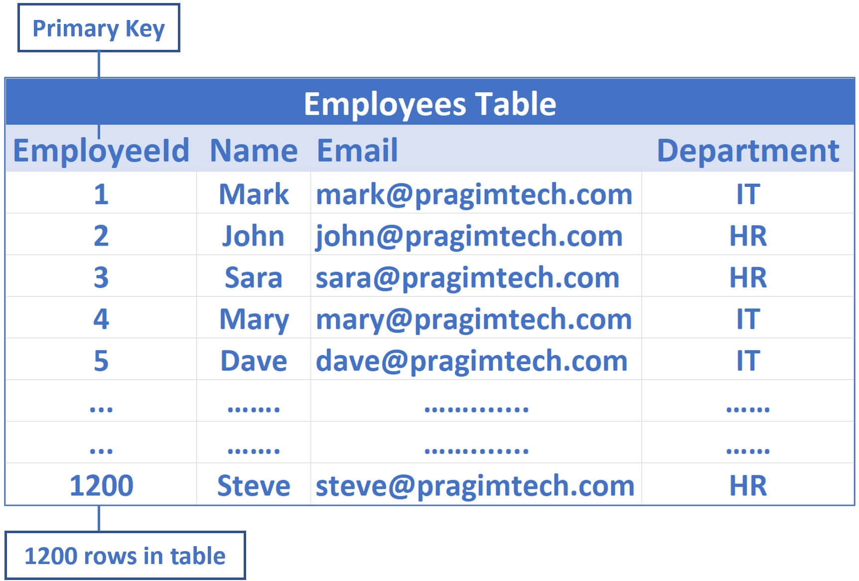
Consider the following Employees table
EmployeeId is the primary key, so by default a clustered index on the EmployeeId column is created.
This means employee data is sorted by EmployeeId column and physically stored in a series of data pages in a tree like structure that looks like the following.

Slide 6
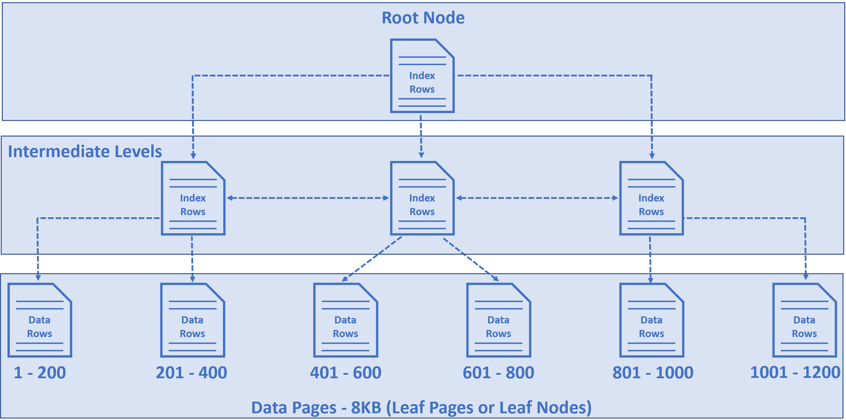
Cont.
These employee rows are sorted by EmployeeId column, because EmployeeId is the primary key and by default a clustered index on this column is created.
The root and the intermediate level nodes contain index rows.
Each index row contains a key value (in our case Employee Id) and a pointer to either an intermediate level page in the B-tree, or a data row in the leaf node.
So this tree like structure has a series of pointers that helps the query engine find data quickly.

Slide 7
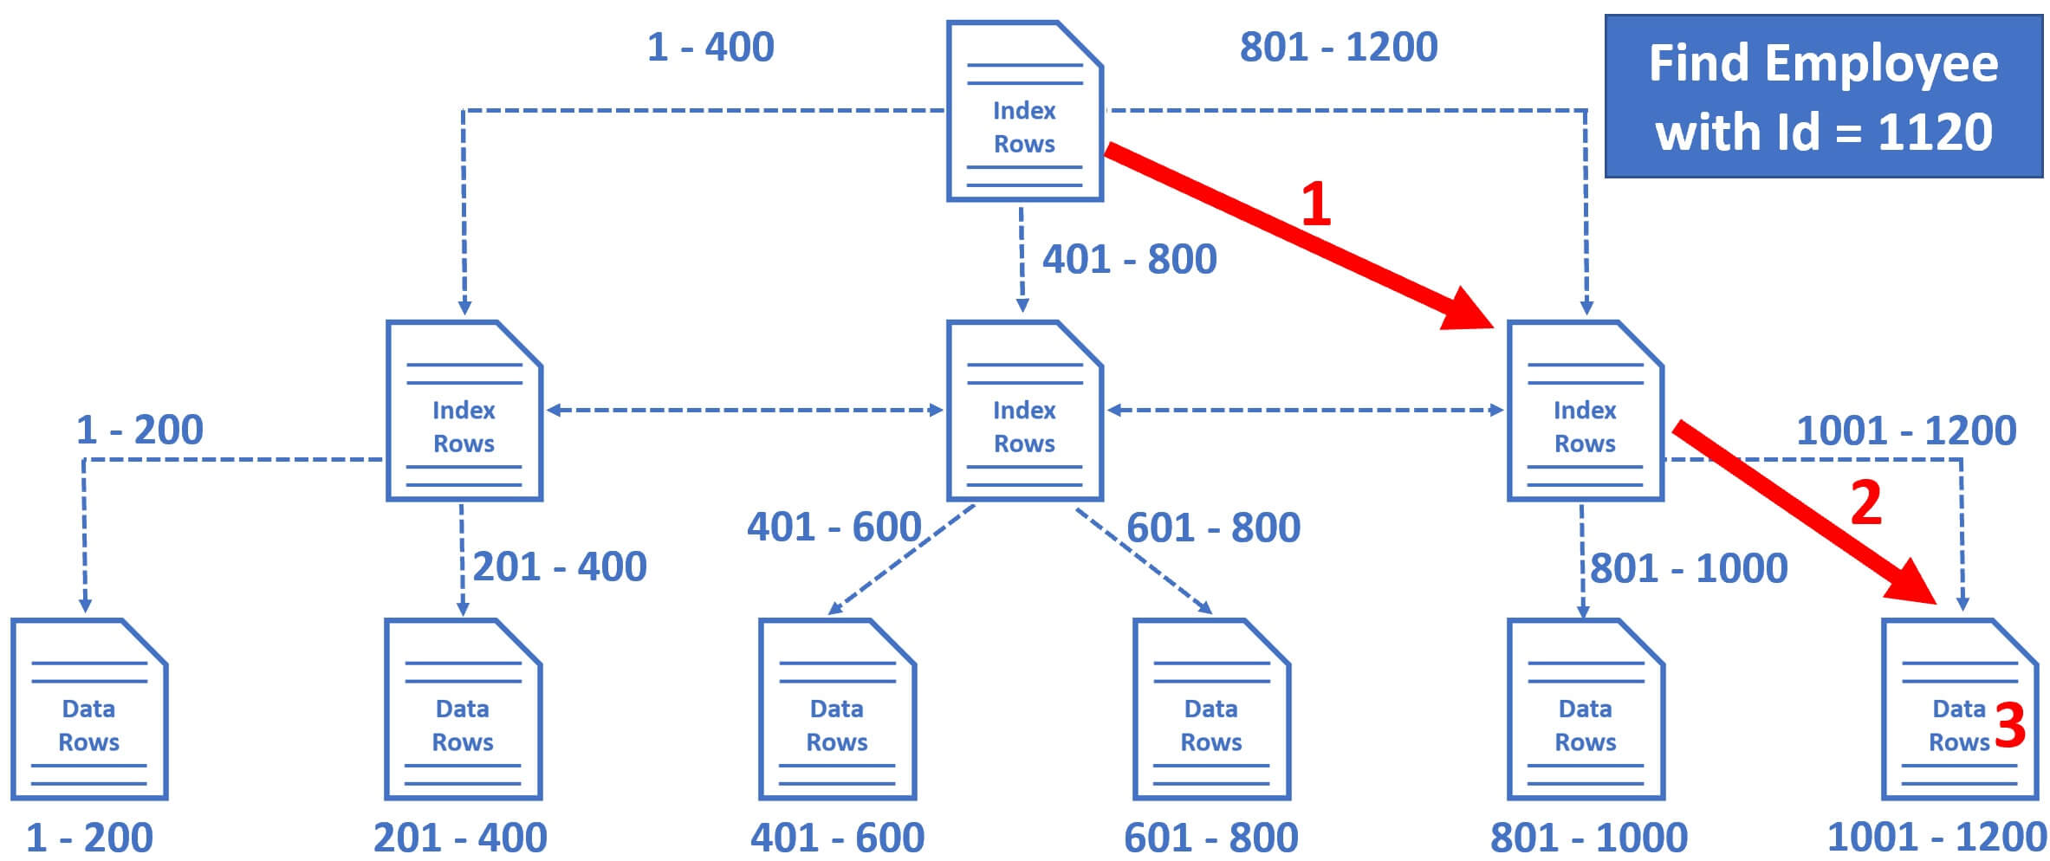
So the database engine starts at the root node and it picks the index node on the right, because the database engine knows it is this node that contains employee IDs from 801 to 1200.
From there, it picks the leaf node that is present on the extreme right, because employee data rows from 1001 to 1200 are present in this leaf node.
The data rows in the leaf node are sorted by Employee ID, so it's easy for the database engine to find the employee row with Id = 1120.

Slide 8
Cont.
In case a table does not have a primary key, which is very rare, you can use the CREATE CLUSTERED INDEX statement to define a clustered index for the table
General syntax:
CREATE CLUSTERED INDEX index_name ON schema_name.table_name (column_list1, column_list2);
CREATE CLUSTERED INDEX ix_employee_id ON Employees Id);
When executing the following statement, SQL Server traverses the index (Clustered index seek) to locate the row, which is faster than scanning the whole table.#
Select * from Employees where Id = 400

Slide 9
Non Clustered Indexes
A nonclustered index is a data structure that improves the speed of data retrieval from tables.
Unlike a clustered index , a nonclustered index sorts and stores data separately from the data rows in the table. It is a copy of selected columns of data from a table with the links to the associated table.
When you create a UNIQUE constraint, a unique nonclustered index is created to enforce a UNIQUE constraint by default

Slide 10
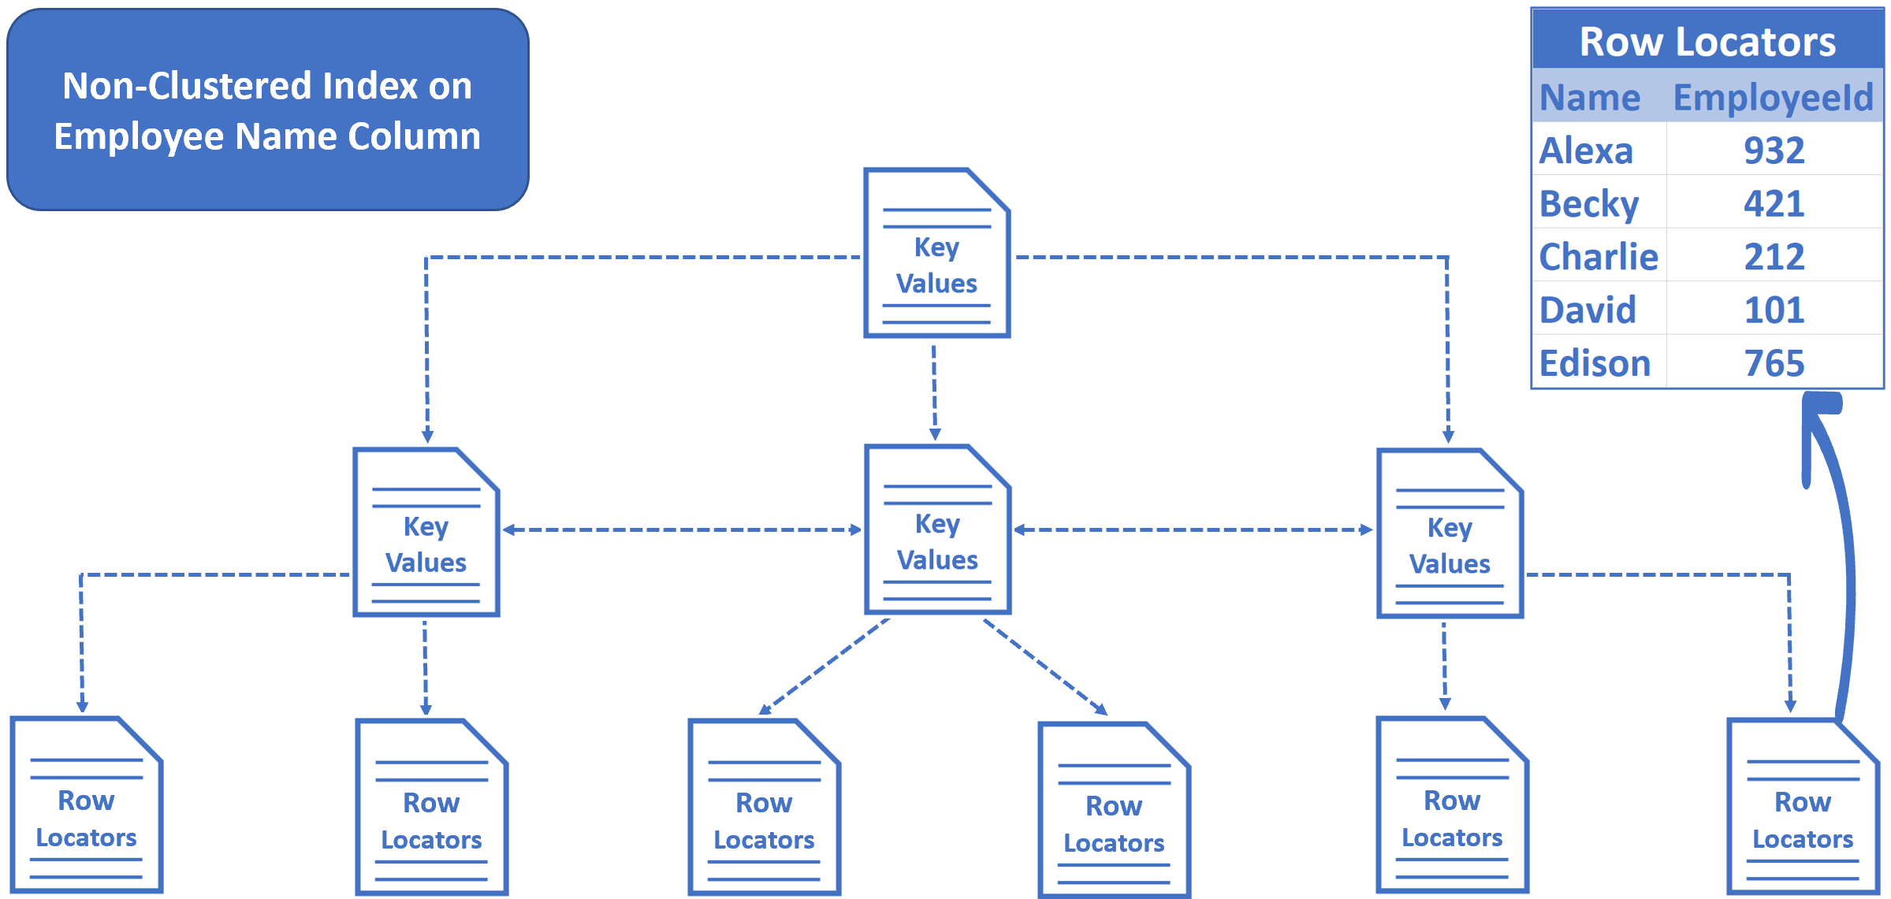
Cont.
In a non-clustered index we do not have table data. We have key values and row locators.
When we create a non-clustered index on the Name column, the key values, in this case Employee names are sorted and stored in alphabetical order.
The row locators at the bottom of the tree contain Employee Names and cluster key of the row. In our example, Employee Id is the cluster key.

Slide 11
Unique Index
A unique index ensures that the index key contains no duplicate values and therefore every row in the table or view is in some way unique.
Uniqueness can be a property of both clustered and nonclustered indexes.
CREATE UNIQUE INDEX index_name ON schema_name.table_name(column_list);

Slide 12
Heap Table
A heap is a table without a clustered index. One or more nonclustered indexes can be created on tables stored as a heap. Data is stored in the heap without specifying an order.

Slide 13
Index seek and Index scan
Index seek - uses the index(clustered or nonclustered) to pinpoint the records that are needed to satisfy the query.
Index scan - used when no condition for the query is specified even though the table might contain a clustered on nonclustered index
Table scan - A table scan is used if there are no indexes to help a query that selects data from a table heap

Slide 14
References
Indexes - SQL Server | Microsoft Docs
An Essential Guide to SQL Server Indexes (sqlservertutorial.net)

